Slide 2
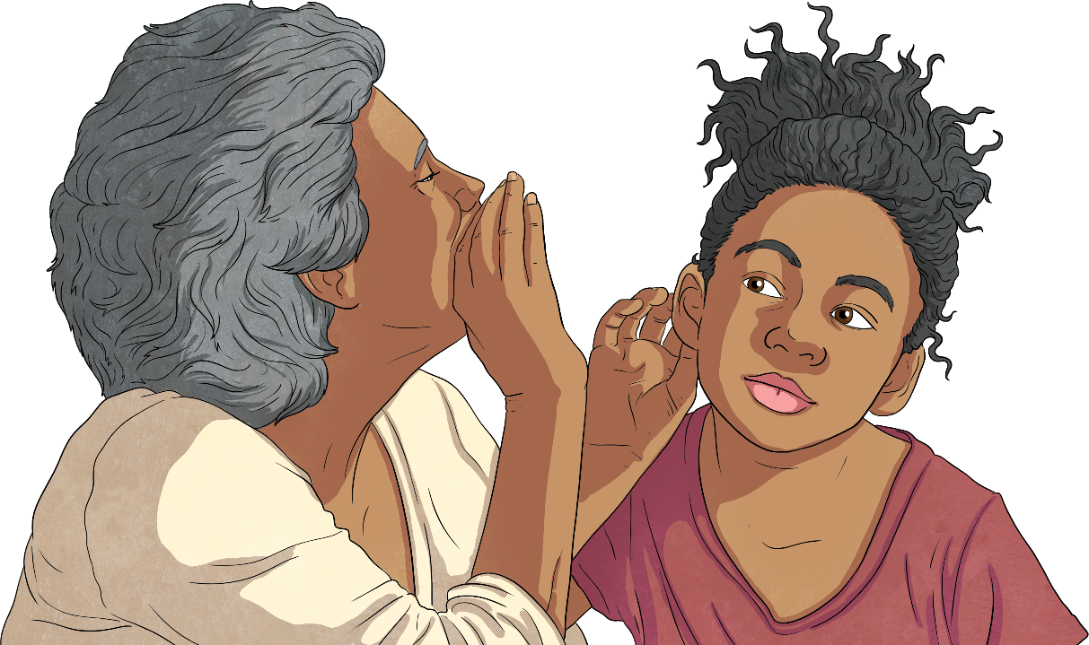
Introduction
Have you heard of Morse code? Perhaps you know what it is but do you know why it was developed or what it looks like?
We’re going to learn about a way of communicating that goes back nearly 200 years and is still in use today.

Slide 3
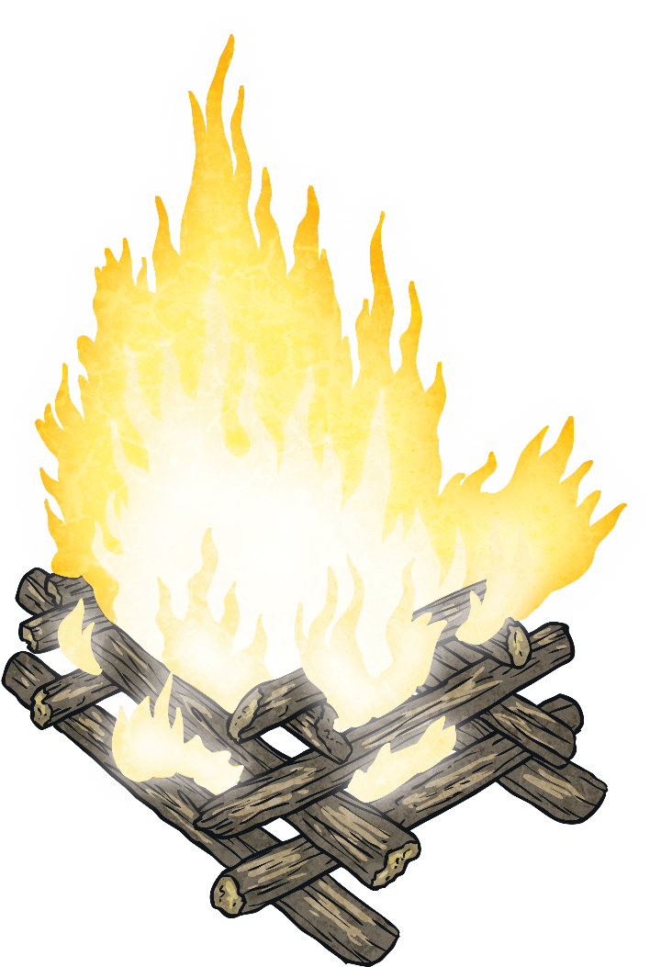
A Brief History of Communication
Thousands of years ago, long before there were phones or computers, people communicated over long distances through smoke signals, flashing sunlight on shiny surfaces, playing drums and written symbols.
Throughout the centuries, people have found more sophisticated ways of communicating over miles of land and in the early 1800s, Morse code was one of them.

Slide 4
A Telegraph
Before we can learn about Morse code, we need to understand what a telegraph is.
A telegraph allows messages to be communicated along a wire over a distance. An electric telegraph requires electrical connections to transmit the signals.
Did You Know…?
The word ‘telegraph’ comes from the Greek words ‘tele’, meaning ‘distant’, and ‘graphein’ which means ‘to write’.

Slide 5
Morse Code
Morse code relies on letters, words and punctuation being represented by dots and dashes. The person receiving the message must know what the arrangements of the dots and dashes mean to be able to read it.
This simple code is effective because it can be sent in a number of ways: visually, such as using a flashing light in short (dot) or long (dash) bursts; in written form with dots and dashes marked on a page or through sound with either short or long ‘beeps’.
Have a go…
See if you can write a message using the dots and dashes. Can your friend work out the message?

Slide 6
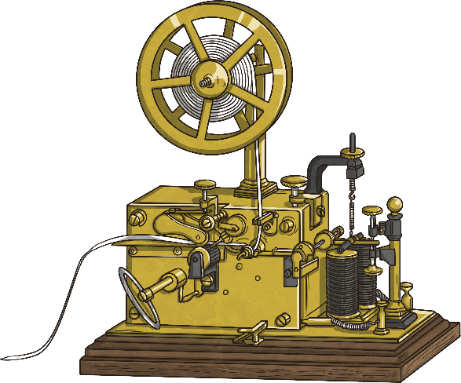
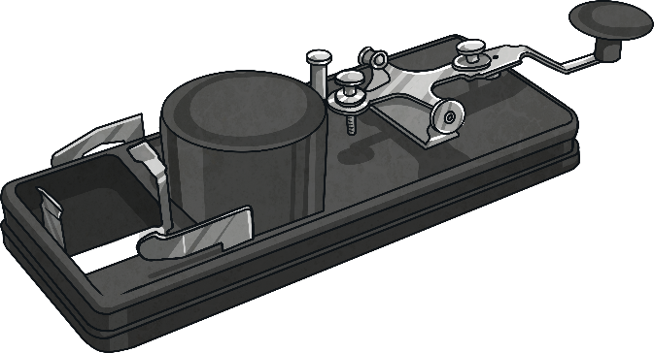
Morse Code
The equipment most commonly used to send and receive a message using Morse code is a telegraph key and a receiver.
The person sending the message taps the round end of the telegraph key which creates an electrical signal. The taps are either short for a dot or long for a dash.
The signal is then transmitted, either through radio waves or along a telegraph wire, to a receiver.
The receiver turns the signal into marks on paper or a sound so the dots and dashes can be decoded and the message understood.

Slide 7
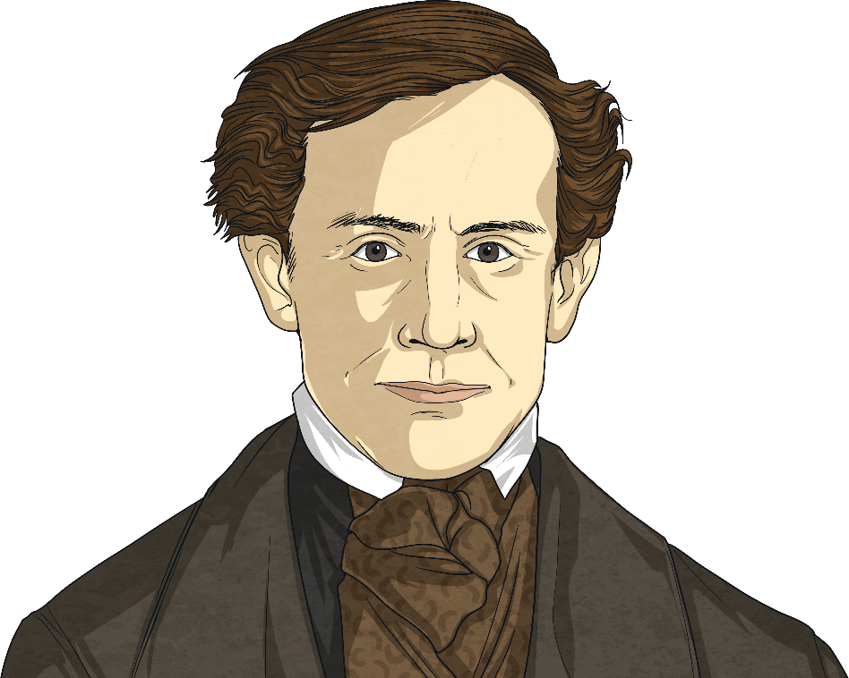
The Inventor
Samuel FB Morse was born 27th April 1791 in Massachusetts, United States. He was an American painter and inventor and he created the electric telegraph and later, Morse code.
He went to Yale University and became interested in a new phenomenon called electricity. After some time spent as an artist, he later became interested in the possibility of an electric telegraph being used to send messages over long distances.
He began working on his invention in 1832 and by 1844, he had developed it as a system that could really work.

Slide 8
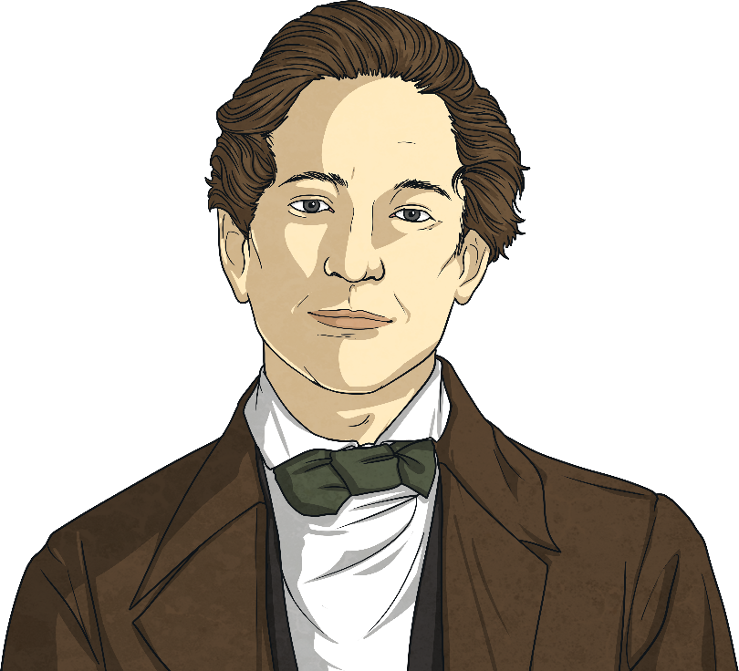
Alfred Vail
At first, Morse’s system only transmitted numbers. The person who received the messages would then need to use a dictionary to translate the numbers into words. This took a long time and wasn’t very efficient.
Samuel Morse began working with another inventor called Alfred Vail. He was a talented mechanic who agreed to construct the telegraph equipment. He improved the design of the Morse code equipment, making it more compact. He also worked out the final form of the code itself. Alfred’s great skill was invaluable to the development of Morse code and how it was transmitted.

Slide 9
The First Message
On 24th May 1844, Morse and Vail were given the opportunity to demonstrate this new invention to the US government called Congress. They were allowed to build an electric telegraph just for the demonstration from Washington DC to Baltimore. It was 35 miles long.
The first message they sent using Morse code was, “What God hath wrought”.
It was a huge success.

Slide 10
World Wars
Before Morse code, messages were still hand written and delivered by hand by a messenger on horseback. The use of Morse code during the First and Second World Wars was invaluable. During the Second World War, Morse code was used as a means of communication between warships and the navy bases. Ordinary radio waves were easily identified by the enemy but messages sent by Morse code could not be so easily deciphered.
War planes used Morse code to tell headquarters of the locations of enemy bases, troops and ships.
The use of the code certainly saved lives as messages were communicated about the effects the weather might have on the warships as well as passing on any intelligence about the whereabouts of the enemy. Messages were sent throughout battles at a very fast speed and were unable to be identified by the enemy.

Slide 11
World Wars
The most common signal for distress is SOS in Morse code. It means Save Our Souls and is sent like this:
… ___ …

Slide 12
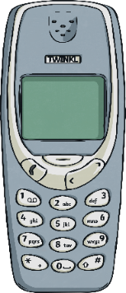
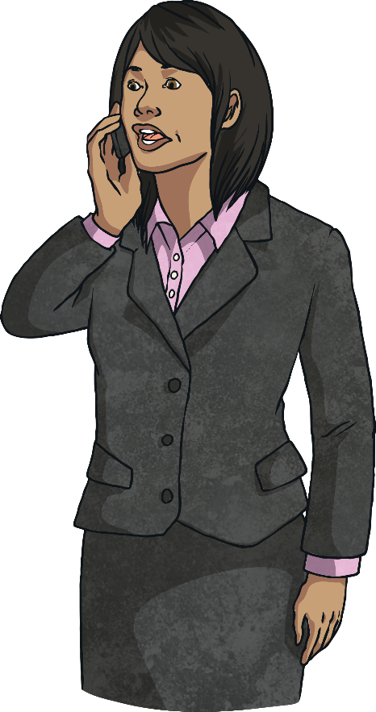
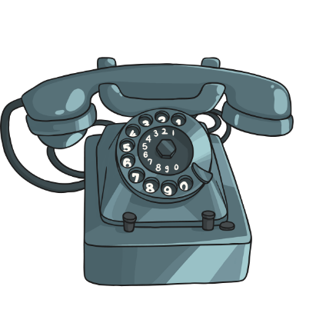
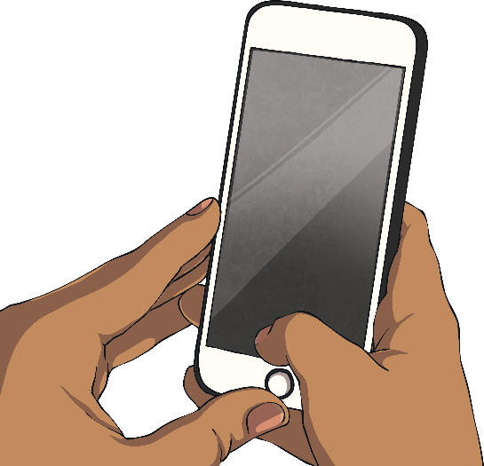
The Morse Legacy
In 1842, Samuel Morse died in New York from pneumonia. He was 81 years old.
Morse’s name lives on through a method of communication that was used for over 100 years and changed the world. It saved lives and paved the way for many inventions from the corded telephone, cordless telephone, video calls to the common mobile phone.

